Slide 1
Atari Game Agents
David Fletcher, Rodney Fulk, Michael Chau

Slide 2
Goal
Research about existing development in Atari game agents
Learn multiple environments for learning reinforcement algorithms
Develop Agents in the Arcade Learning Environment
Compare performance of agents

Slide 3

Arcade Learning Environment
Object Oriented Framework in C++ for research to develop agents
Built on the Stella Emulator
Ability to visualize agents playing games

Slide 4
ALE Python Interface
Wrapper for the Arcade Learning Environment
Allows access to all legal actions for a game
Allowed us not to code in C++

Slide 5

OpenAI Gym
Toolkit for developing and comparing reinforcement learning algorithms
Supports multiple environments for training agents
Includes Arcade Learning Environment
Environments range from Atari to Minecraft
Python interface

Slide 6
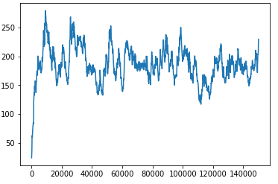
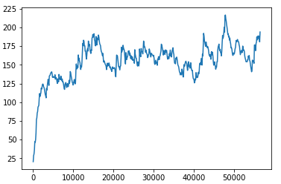
Training
Deep RL
A2C

Slide 7
Problems Encountered
Setting up Environments
Compatibility between environment and agents
Hardware limitations
Excessive Training Time

Slide 8
Conclusions
ALE and OpenAI Gym are cool
Installing dependencies is not fun
Games are a great way to evaluate AI algorithms

Slide 9
Links to projects:
Open AI Gym: https://gym.openai.com/
Class resource: https://github.com/yandexdataschool/AgentNet
Class on using Gym: https://github.com/yandexdataschool/Practical_RL

